Slide 1


Saif Al-Dilaimi
Software Entwickler
saif.aldilaimi@icloud.com
Der Fully Connected Layer (Dense)

Slide 2
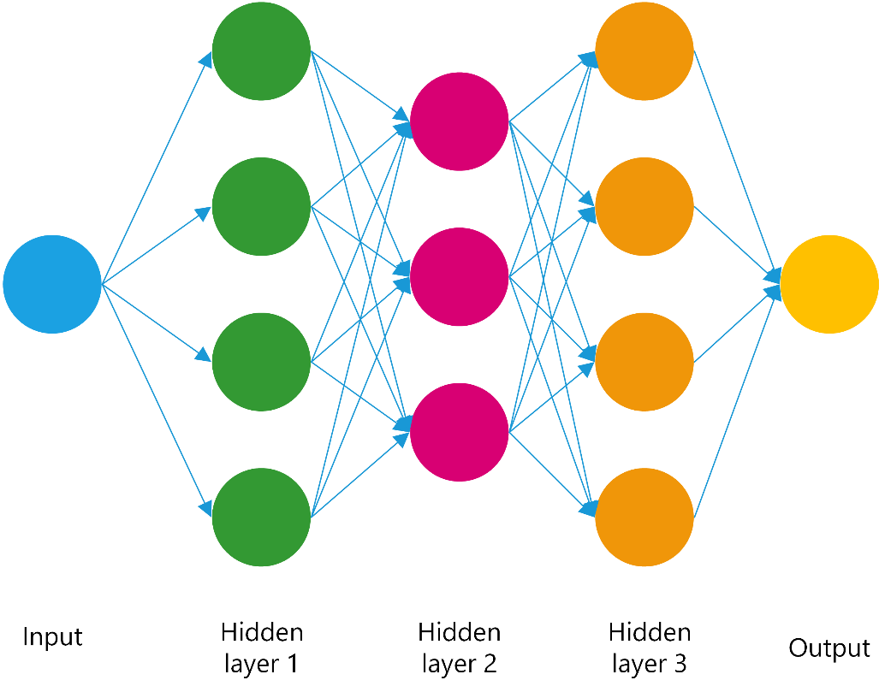
Keras Neuronales Netz
X
Y

Slide 3
Keras Dense Layer
Dense(256, activation=´relu´)
model.add(Dense(...))
1
Dense(...)
2
Units
activation=None
use_bias=True
kernel_initializer='glorot_uniform‘,
bias_initializer='zeros‘
kernel_regularizer=None
bias_regularizer=None
activity_regularizer=None
kernel_constraint=None
bias_constraint=None
X
…
256

Slide 4

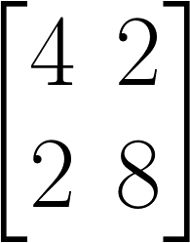
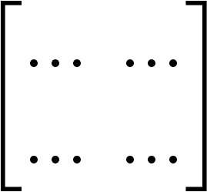
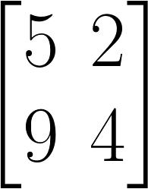





Keras Dense Layer
Dense(256)
1
$$\left[\begin{matrix}5 \\ 1\end{matrix}\right]∙{\left[\begin{matrix}1 & 2 \\ 1 & 6\end{matrix}\right]}^{T}$$
=
$$\left[\begin{matrix}5 \\ 1\end{matrix}\right]$$
2
$$\left[\begin{matrix}5 \\ 1\end{matrix}\right]∙{\left[\begin{matrix}4 & 2 \\ 2 & 8\end{matrix}\right]}^{T}$$
=
X
…
$$\left[\begin{matrix}5 \\ 1\end{matrix}\right]∙{\left[\begin{matrix}⋯ & ⋯ \\ ⋯ & ⋯\end{matrix}\right]}^{T}$$
=
256
$$\left[\begin{matrix}5 \\ 1\end{matrix}\right]∙{\left[\begin{matrix}5 & 2 \\ 9 & 4\end{matrix}\right]}^{T}$$
=

Slide 5
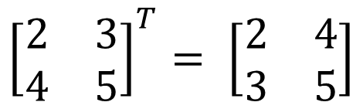
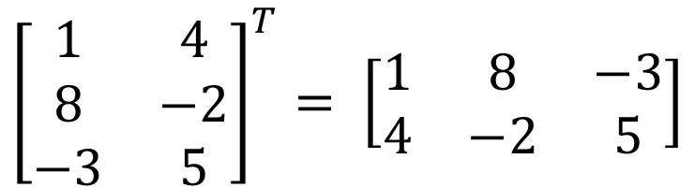




Keras Dense Layer
$${\left[\begin{matrix}2 & 3 \\ 4 & 5\end{matrix}\right]}^{T}= \left[\begin{matrix}2 & 4 \\ 3 & 5\end{matrix}\right]$$
$$2×2$$
$$2×2$$
$${\left[\begin{matrix}1 & 4 \\ 8 & −2 \\ −3 & 5\end{matrix}\right]}^{T}= \left[\begin{matrix}1 & 8 & −3 \\ 4 & −2 & 5\end{matrix}\right]$$
$$3×2$$
$$2×3$$

Slide 6





Keras Dense Layer
output = activation( dot( input, kernel ) + bias )
Input $X :=n$ Vektor
$$y=x∙w^{T}+b$$
Kernel $W :=m x n$ Matrix
Bias $b := n$ Vektor
Output $Y :=m x n$ Matrix

Slide 7
Saif Al-Dilaimi
Software Entwickler
saif.aldilaimi@icloud.com
Danke fürs Zuhören!
Gleich geht es weiter mit dem nächsten Thema.

